Slide 1
LESSON FOURTEEN
TOPICS: HOW TO KEEP TRACK OF AMMO, AND HOW TO RESPOND TO RUNNING OUT OF AMMO.

Slide 2
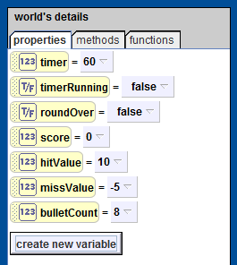
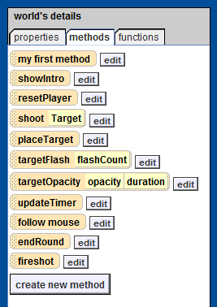
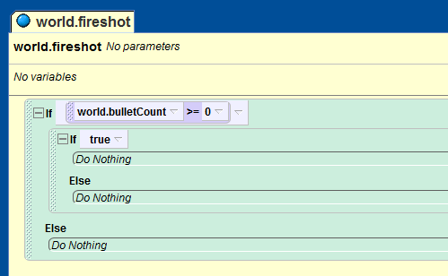
Step 1: How to Set Up a Bullet Counter
Create a new number variable for the world object called “bulletCount”.
Set the default value for bulletCount to “8”.
Create a new method for the world object called “fireshot”.
Add an if statement to the “world.fireshot” method.
Add a second, nested if statement to the first option of the previous if statement.
Set to condition for the first if statement to “world.bulletCount >= 0”

Slide 3
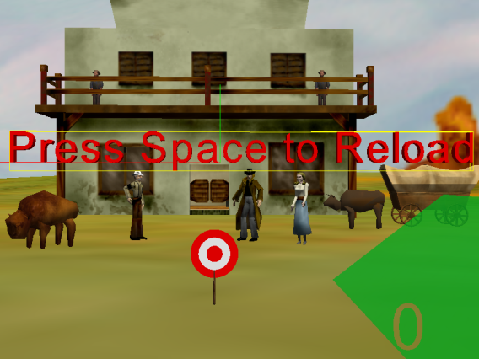
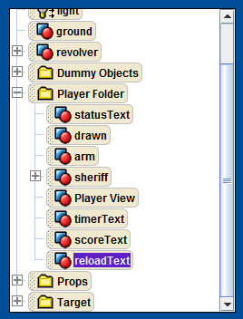
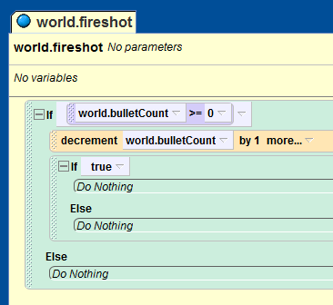
Step 2: How to Decrement the Bullet Counter
Add the line
right before the second if statement in the “world.fireshot” method.
Make sure that the camera’s point of view is the same as PlayerView.
Create a new 3D text object called “reloadText”.
Set the text property for the reloadText object to “Press Space to Reload”.
Set the font property for the reloadText object to “Dialogue.”
Set the color property for the reloadText object to “red.”

Slide 4
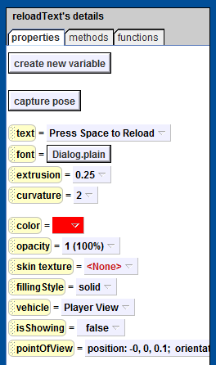
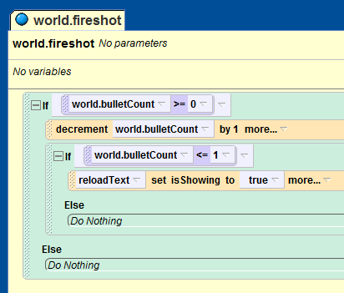
Step 3: Create the Reload Text
Set the reloadText object properties as following:
reloadText.opacity = “1.”
reloadText.extrusion = “0.25.”
reloadText.isShowing = “false.”
Set to condition for the second if statement in the world.fireshot method to “world.bulletCount <= 1”
Add the line “reloadText.isShowing = true” to the first option of the nested, or second, if statement.

Slide 5
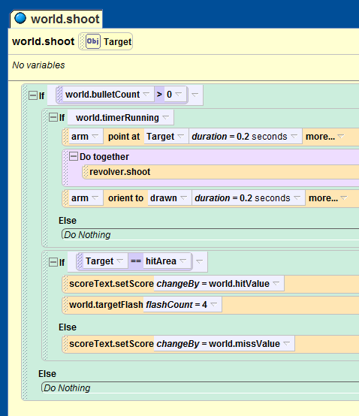
Step 4: How to Use the Bullet Counter
Add and “if statement” to the top of the “world.shoot” method.
Set the conditional of this new if statement to “world.bulletCount > 0.”
Move all of the previous lines of code from the “world.shoot” method into this new if statement.
Add a new “do together” clause to the “world.shoot” method right before the line:
Move the “revolver.shoot” line into the new “do together” clause.

Slide 6
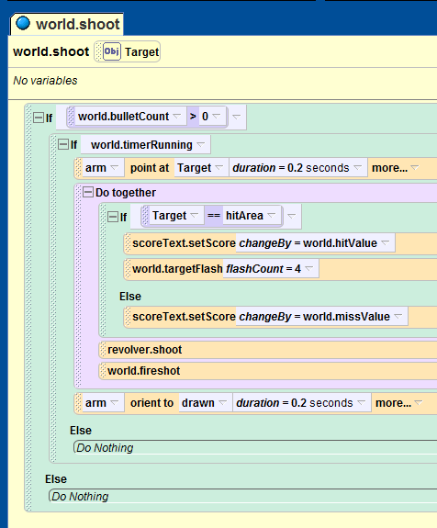
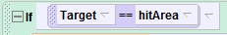
Step 5: Finishing the Bullet Counter Logic
Drag-and-drop the
statement from the “world.shoot” method into the “do together” clause from Step 4 right before the “revolver.shoot” line.
Add the “world.fireshot” method to the new “do together” clause.

Slide 7
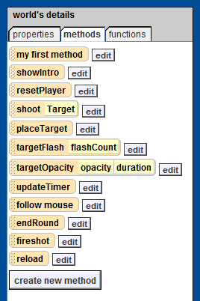
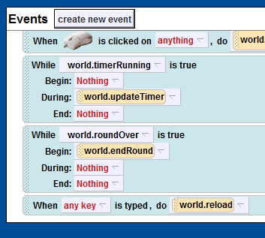
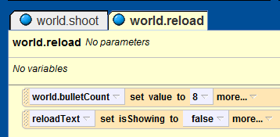
Step 6: How to Capture the Reload Event
Create a world method called “reload”.
Add the following lines to the reload method:
“world.bulletCount = 8”.
“reloadText.isShowing = false”.
Create a new “when a key is typed” event.
Set the input for the new event to “any key.”
Set the method call for the new event to “world.reload.”

Slide 8
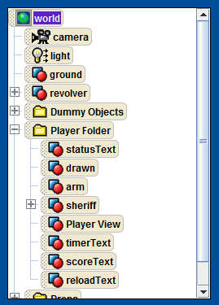
Step 7: Let’s Keep Things Organized!
Make sure that the reloadText object is in the Player folder.

Slide 9
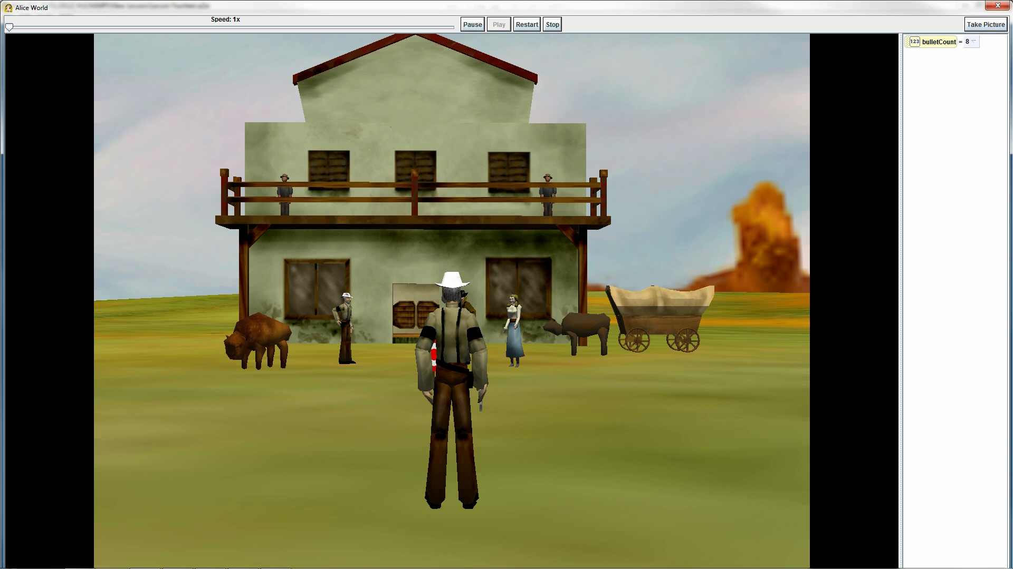
Final Scene

